Slide 1
DIABETES PREDICTION ANALYSIS
PSYLIQ Internship Project
Shravan Birajdar
www.linkedin.com/in/shravan-ramesh-birajdar-28a58b137

Slide 2

DIABETES PREDICTION ANALYSIS

Slide 3

Project Description
Diabetes is a chronic disease affecting millions worldwide, leading to devastating complications like cardiovascular disease, nephropathy, and neuropathy. Early diagnosis and intervention are crucial in managing the disease and preventing these complications. However, traditional methods rely on reactive diagnoses after symptoms emerge.
Project Aim: This project aims to develop a data driven approach for predicting diabetes and its complications at an early stage using SQL.
Objectives: Develop a predictive model: Utilize patient data including demographics, medical history, lifestyle factors and clinical metrics to build a machine learning model for accurately predicting the onset of diabetes and its potential complications.
Identify key risk factors: Analyse the model to understand the significant contributing factors for diabetes and its complications, facilitating targeted prevention strategies.
Personalize interventions: Design a system that delivers personalized recommendations for lifestyle modifications, medical monitoring and early treatment based on individual risk profiles.
Improve early detection: Develop an interactive platform for healthcare professionals to assess individual risk based on readily available data, enabling earlier intervention and better disease management.

Slide 4

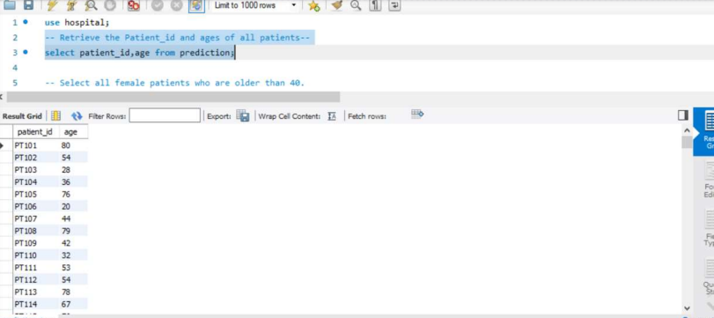
DIABETES PREDICATION ASSESSMENT
1. Retrieve the Patient_id and ages of all patients.

Slide 5
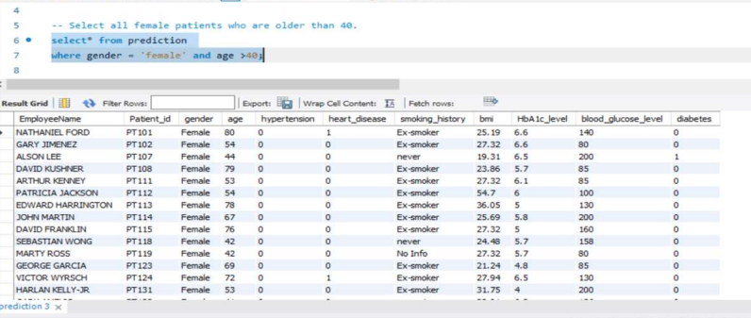
DIABETES PREDICATION ASSESSMENT
2. Select all female patients who are older than 40.

Slide 6
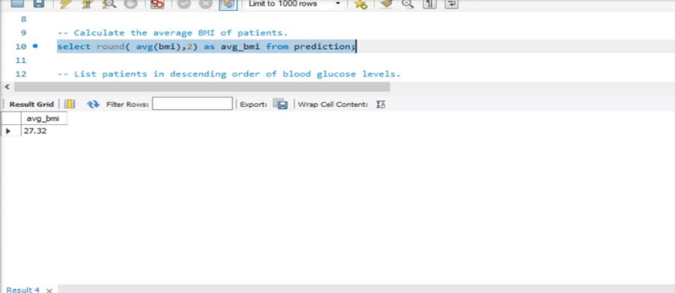
DIABETES PREDICATION ASSESSMENT
3. Calculate the average BMI of patients.

Slide 7
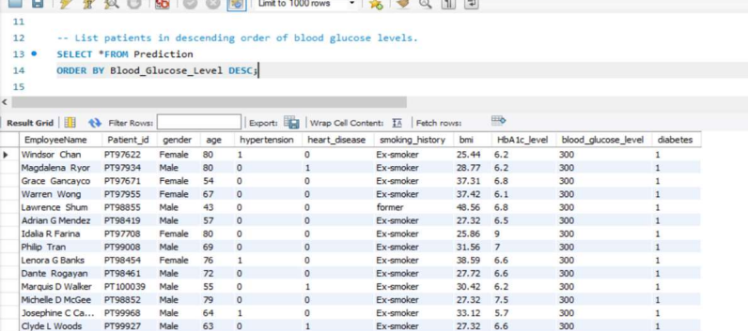
DIABETES PREDICATION ASSESSMENT
4. List patients in descending order of blood glucose levels.

Slide 8
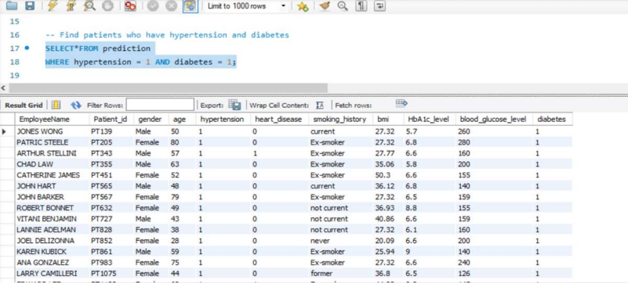
DIABETES PREDICATION ASSESSMENT
5. Find patients who have hypertension and diabetes.

Slide 9
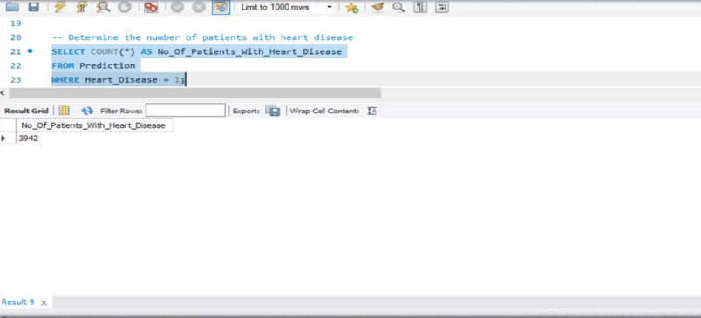
DIABETES PREDICATION ASSESSMENT
6. Determine the number of patients with heart disease.

Slide 10
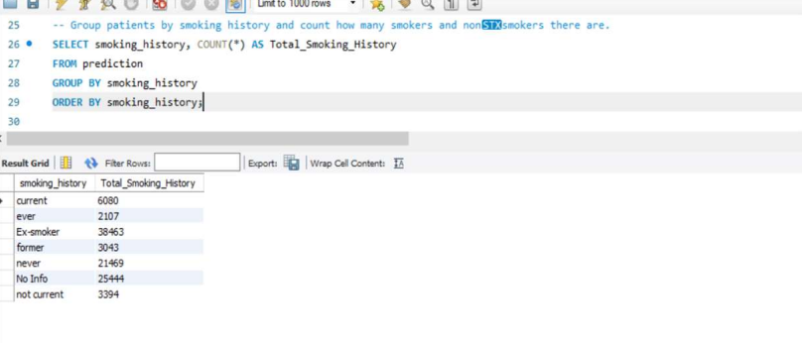
DIABETES PREDICATION ASSESSMENT
7. Group patients by smoking history and count how many smokers and nonsmokers there are.

Slide 11
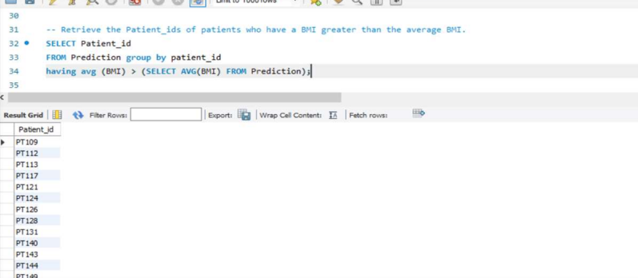
DIABETES PREDICATION ASSESSMENT
8. Retrieve the Patient_ids of patients who have a BMI greater than the average BMI.

Slide 12
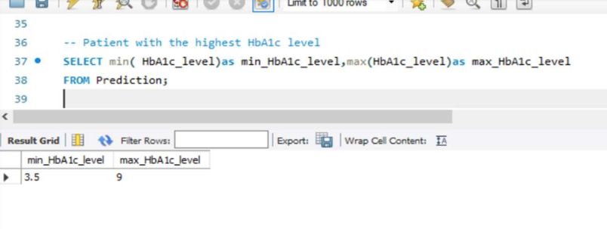
DIABETES PREDICATION ASSESSMENT
9. Find the patient with the highest HbA1c level and the patient with the lowest HbA1clevel.

Slide 13
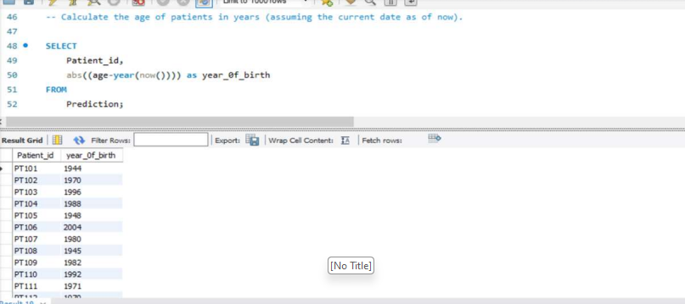
DIABETES PREDICATION ASSESSMENT
10. Calculate the age of patients in years (assuming the current date as of now).

Slide 14
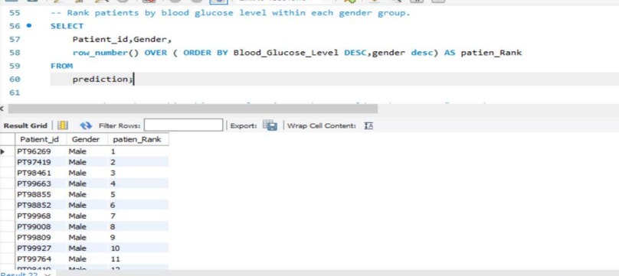
DIABETES PREDICATION ASSESSMENT
11. Rank patients by blood glucose level within each gender group.

Slide 15
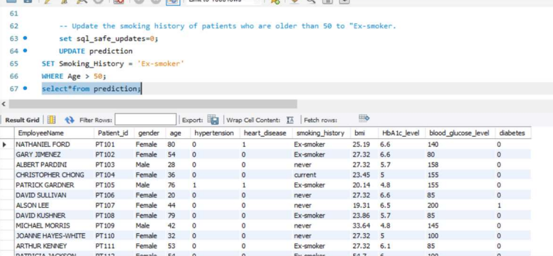
DIABETES PREDICATION ASSESSMENT
12. Update the smoking history of patients who are older than 50 to "Ex-smoker."

Slide 16
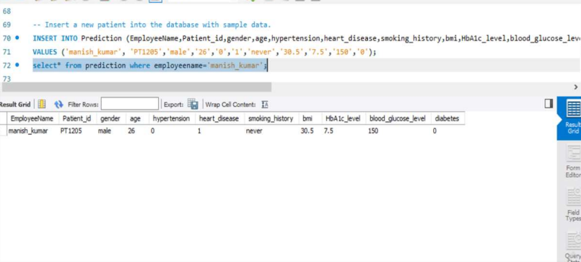
DIABETES PREDICATION ASSESSMENT
13. Insert a new patient into the database with sample data.

Slide 17
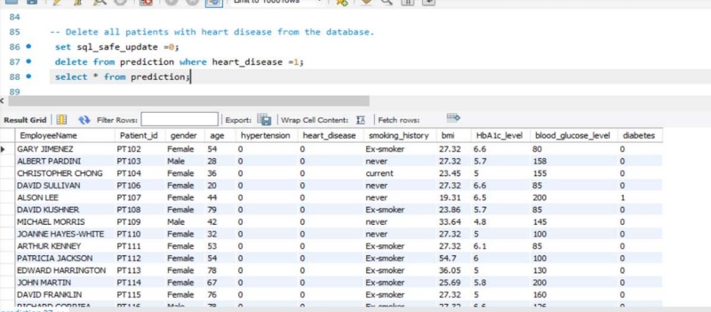
DIABETES PREDICATION ASSESSMENT
14. Delete all patients with heart disease from the database.

Slide 18
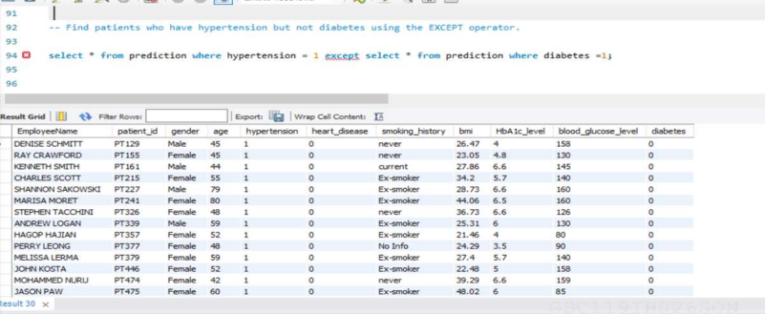
DIABETES PREDICATION ASSESSMENT
15. Find patients who have hypertension but not diabetes using the EXCEPT operator.

Slide 19
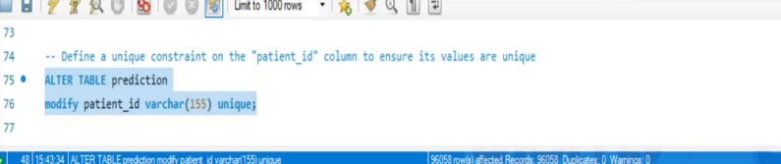
DIABETES PREDICATION ASSESSMENT
16. Define a unique constraint on the "patient_id" column to ensure its values are unique.

Slide 20
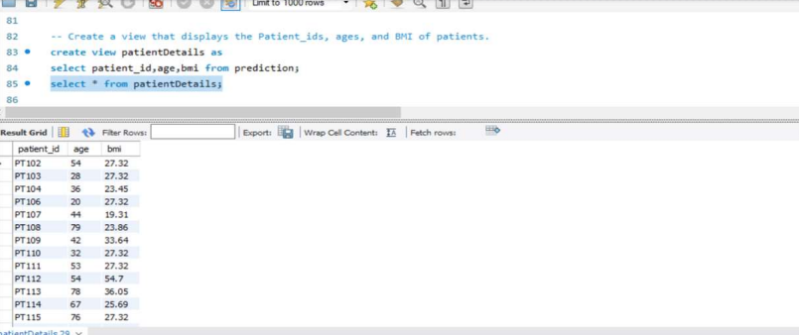
DIABETES PREDICATION ASSESSMENT
17. Create a view that displays the Patient_ids, ages, and BMI of patients.

Slide 21
DIABETES PREDICATION ASSESSMENT
18. Suggest improvements in the database schema to reduce data redundancy and improve data integrity.
Normalization: Ensure the database is in at least 3rd Normal Form (3NF) or Boyce-Codd Normal Form (BCNF). Eliminate repeating groups and organize data into related tables.
Primary and Foreign Keys: Use primary keys to uniquely identify each record in a table. Utilize foreign keys to establish relationships between tables. Enforce referential integrity to maintain consistency across related tables.
Composite Primary Keys: Consider using composite primary keys when necessary to ensure uniqueness. Be cautious with composite keys and only use them when it makes logical sense.
Data Types and Constraints: Use appropriate data types for each column. Implement constraints to restrict the type and range of data that can be entered.
Denormalization for Performance: Consider denormalization for performance optimization in read-heavy scenarios. Evaluate trade-offs between normalization and denormalization based on specific use cases.
Normalization Review: Periodically review and adjust normalization based on evolving business requirements.

Slide 22
DIABETES PREDICATION ASSESSMENT
19. Explain how you can optimize the performance of SQL queries on this dataset.
Query Rewriting: Rewrite queries to use efficient and selective filters in the WHERE clause. Avoid using wildcard characters at the beginning of LIKE patterns.
Avoid SELECT : Only retrieve the columns needed for the query rather than using SELECT *. Minimize the amount of data transferred from the database to the application.
Use JOINs Wisely: Optimize JOIN operations by selecting appropriate JOIN types (INNER JOIN, LEFT JOIN, etc.). Ensure that the columns used for JOIN conditions are indexed.
Avoid Subqueries: Rewrite subqueries as JOINs where possible for better performance.
Aggregate Functions: Use aggregate functions (SUM, AVG, COUNT, etc.) selectively. Avoid unnecessary use of DISTINCT.
Normalization and Denormalization: Strike a balance between normalization for data integrity and denormalization for query performance. Consider materialized views for frequently accessed aggregated data.

Slide 23
𝐊𝐞𝐲 𝐈𝐧𝐬𝐢𝐠𝐡𝐭𝐬:🔑
DIABETES PREDICATION ASSESSMENT
In this project, the focus is on managing a patient database with essential health information, encompassing patient IDs, ages, gender, BMI, blood glucose levels, and medical conditions like hypertension, diabetes, and heart disease. The primary goal is to leverage SQL operations to derive valuable insights from the data, including the identification of specific patient groups, computation of averages, and maintenance of data integrity.
The project aims to optimize the database management process, elevate data analysis capabilities, and enhance the overall efficiency of healthcare data management. By addressing these tasks, the project seeks to contribute to streamlined healthcare processes and improved patient care.
𝐏𝐫𝐨𝐣𝐞𝐜𝐭 𝐈𝐦𝐩𝐚𝐜𝐭:📈
Contributed to a comprehensive analysis of healthcare data, providing valuable insights into patient health profiles and trends related to diabetes occurrence.

Slide 24
Thank You…
Shravan Birajdar Data Analyst Intern at PSYLIQ

